Slide 1
‘Busy’ Record, Put-callback Lab
Kay Kasemir
July 2026

Slide 2
Adding Busy Record to IOC
Busy record is not included in EPICS base.
Add to IOC via SomeApp/src/Makefile
Some_DBD += busySupport.dbd
Some_LIBS += busy
See /ics/examples/18_busy/busyApp/src/Makefile

Slide 3
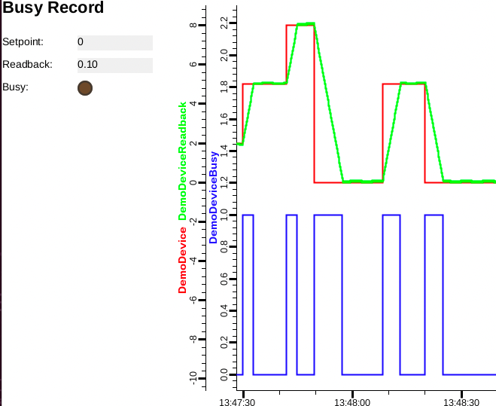
Example: /ics/examples/18_busy
Read …busyApp/Db/busy_demo.db
cd …iocBoot/iocbusy; ./st.cmd
Open BusyDemo.bob
Try the following,
explain what’s happening
  caput DemoDevice 2
  caput DemoDevice 5
  caput –c –w 20 DemoDevice 2
  caput –c –w 20 DemoDevice 5
  caput –c DemoDevice 2

Slide 4
Example: /ics/examples/18_busy
Look at …/automate.sh
  What could be problematic with those `caput` calls?
  On the IOC, check `casr 2`
Compare with …/automate.py
For PV Access, ‘-c’ turns into
  pvput -r 'record[block=true]' -w 20 DemoDevice 5

